Slide 1
SMART COMMUNICATIONS
PIP2001 Capstone Project
Review-0
Batch Number: CAI-G02
Roll Number | Student Name
20211CAI0044 | K. Midhun Kumar
20211CAI0053 | G. Sunil Kumar Reddy
20211CAI0110 | Akash S
20211CAI0127 | D. Narasimha Rao
20211CAI0160 | S. Siva Anjaneyulu
Under the Supervision of,
Dr. Zafar Ali Khan
Associate Professor
School of Computer Science and Engineering
Presidency University
Name of the Program: Computer science and Engineering (AI & ML)
Name of the HoD: Dr. Zafar Ali Khan N
Name of the Program Project Coordinator: Dr. Afroz Pasha
Name of the School Project Coordinators: Dr. Sampath A K / Dr. Abdul Khadar A / Mr. Md Ziaur Rahman

Slide 2
Content
Problem Statement
Github Link
Analysis of Problem Statement
Timeline of the Project
References

Slide 3
Problem Statement Number: PSCS193
Organization: Human Welfare Association, Varanasi
Category (Hardware / Software / Both) : Software
Problem Description:
Our platform empowers rural artisans by allowing them to register, showcase their products, and track sales statistics. Artisans can create and join local events, enhancing community connections and visibility. Initially, they can sell five items via Cash On Delivery to verify authenticity, after which multiple payment options become available. Additionally, we promote popular products and announce an "Artisan of the Month" to motivate and support their craft.
Difficulty Level: Simple

Slide 4
Github Link
https://github.com/midhun33-sudo/website_for_artisan

Slide 5
Technology Stack Components
Frontend Technologies
Languages: HTML5, CSS3, JavaScript
Frameworks/Libraries:
React.js / Angular / Vue.js: For building interactive and responsive user interfaces.
Backend Technologies
Programming Languages/Frameworks:
Node.js with Express.js / Python with Django or Flask
Database Solutions:
PostgreSQL / MySQL / MongoDB

Slide 6
Technology Stack Components
Authentication and Security:
Services: Auth0 / Firebase Authentication
Authentication Methods: OAuth / JWT
Payment Processing:
Gateways: Stripe / PayPal / Square
Hosting and Deployment:
Cloud Platforms: AWS / Google Cloud Platform / Microsoft Azure
Containerization: Docker / Kubernetes (If usable)

Slide 7
Software and Hardware Requirements
Software
Development Tools: Visual Studio Code / IntelliJ IDEA / WebStorm
Database Management: Prisma / Sequelize /Microsoft SQL Server Management
Version Control: Git, GitHub / GitLab / Bitbucket

Slide 8
LIMITATIONS
Artisan Challenges
Market Reach: Difficulty in accessing global markets due to geographic and economic barriers.
Product Management: Lack of effective tools for managing and promoting products online.
Event Coordination: No structured platform for organizing or participating in artisan events.

Slide 9
SOLUTION
Proposed Solution
Centralized Platform: A web-based marketplace tailored for showcasing and selling ethnic crafts.
Analytics Tools: Features to track sales, rankings, and product views.
Event Management: Tools for creating, joining, and managing artisan events.
Flexible Payments: Multiple payment options including COD and online payments.

Slide 10
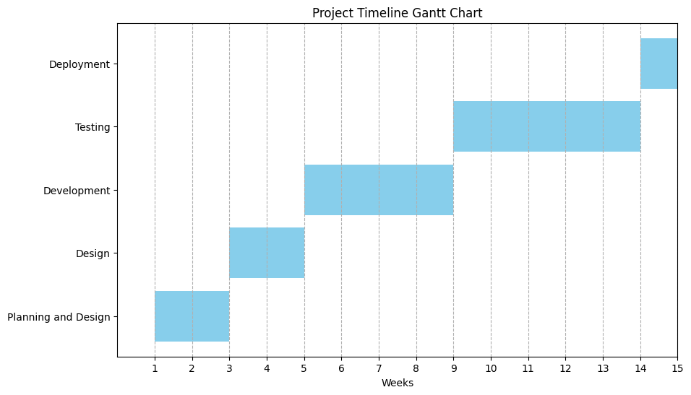
Timeline of the Project (Gantt Chart)

Slide 11
References (IEEE Paper format)
https://www.chanderiyaan.com
https://gaatha.com

Slide 12


